Slide 1
數位IC設計 作業解說
2018-09-28
NCKU CSIE DICLAB

Slide 2
The process
The process and the tools you will use
The tools and tutorial for setup can be downloaded from ftp
ftp : 140.116.245.92
Username : ic_design
Password : ic_design
Folder : Tool
Functional simulation
Synthesis
Gate Level simulation
ModelSim
Quartus
ModelSim

Slide 3
Functional Simulation by ModelSim

Slide 4
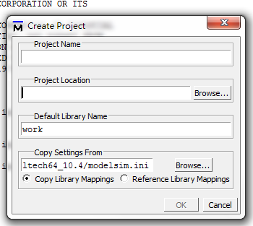
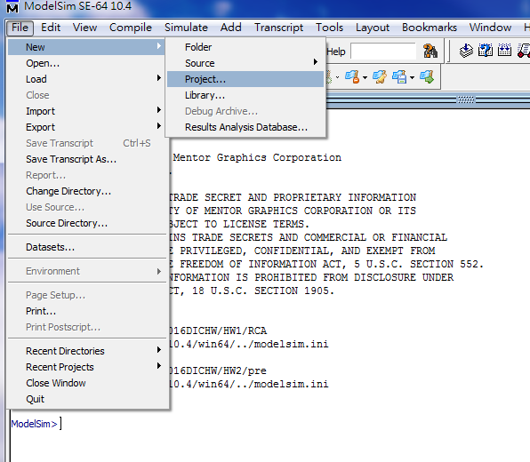
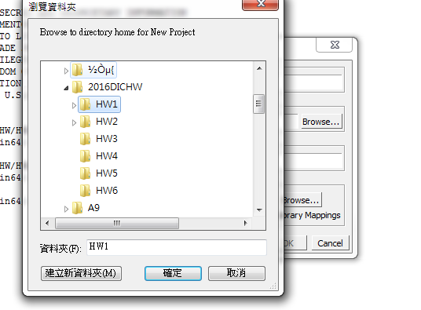
Functional Simulation by ModelSim
Step1: Create a new project
File -> New -> Project
Click “Browse…”
The name of your project
Click here
The file path should be ALL ENGLISH
The location of your project

Slide 5
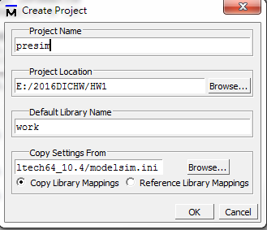
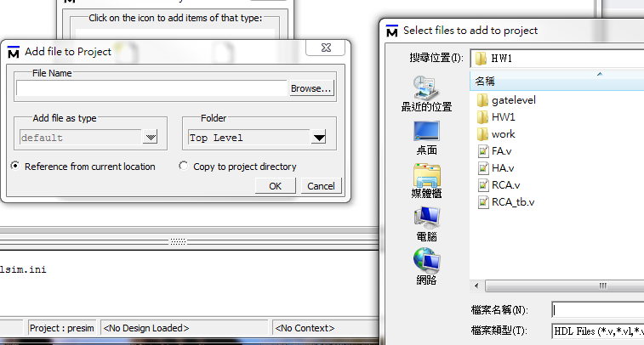
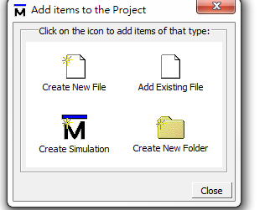
Functional Simulation by ModelSim
Step 2: add the files
Select all the files including the testbench
Click here
Click here
Click here

Slide 6
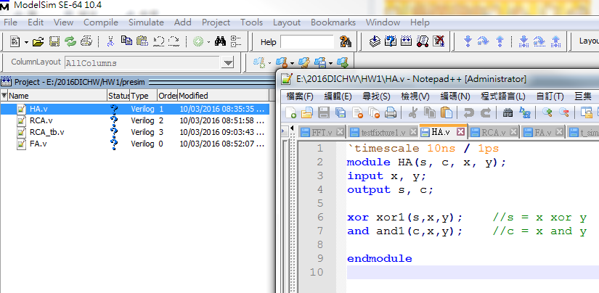
Functional Simulation by ModelSim
Step3 : start coding…

Slide 7
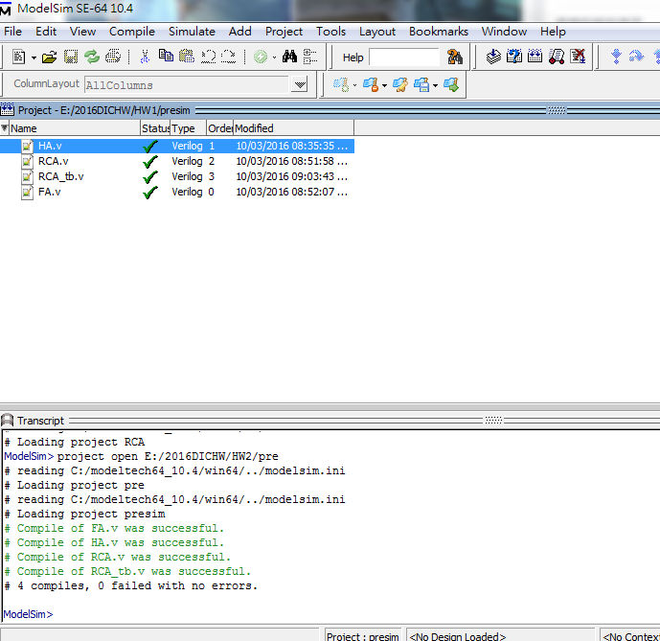
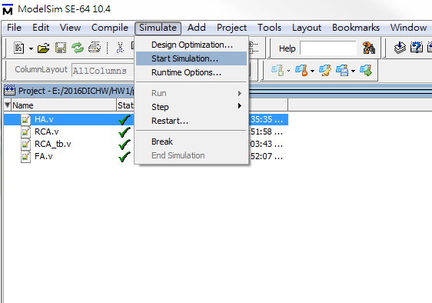
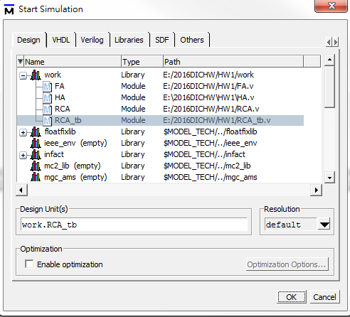
Functional Simulation by ModelSim
Step4: simulation
Compile -> Simulate -> Start Simulation->work->tb
Click here

Slide 8
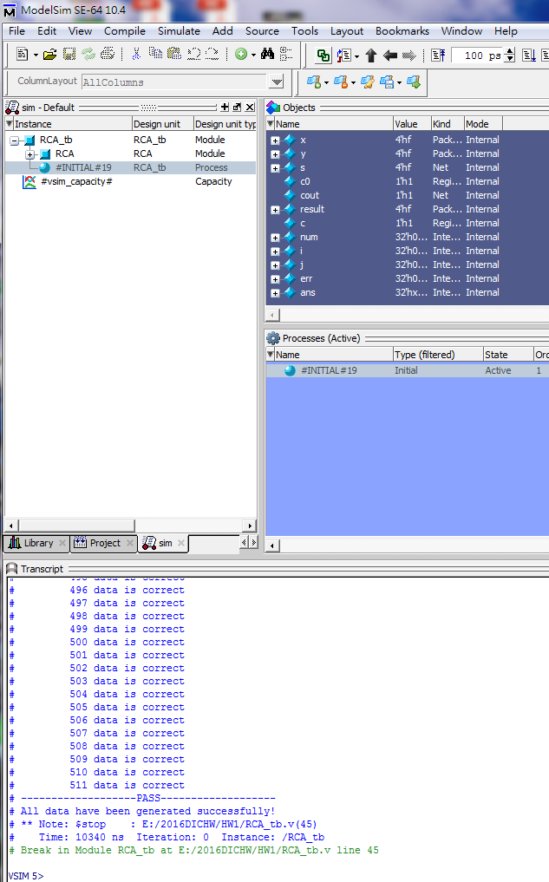
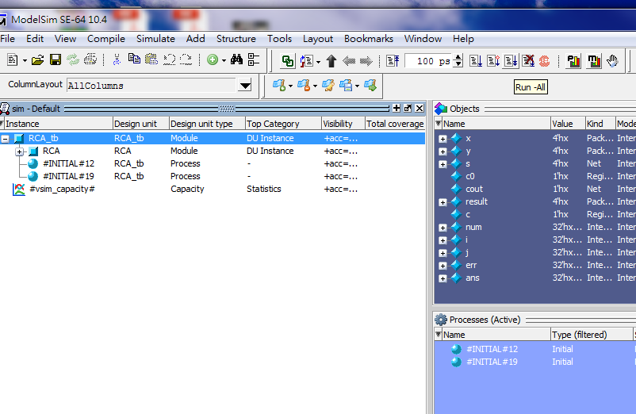
Functional Simulation by ModelSim
Step 4 : simulation
Click here

Slide 9
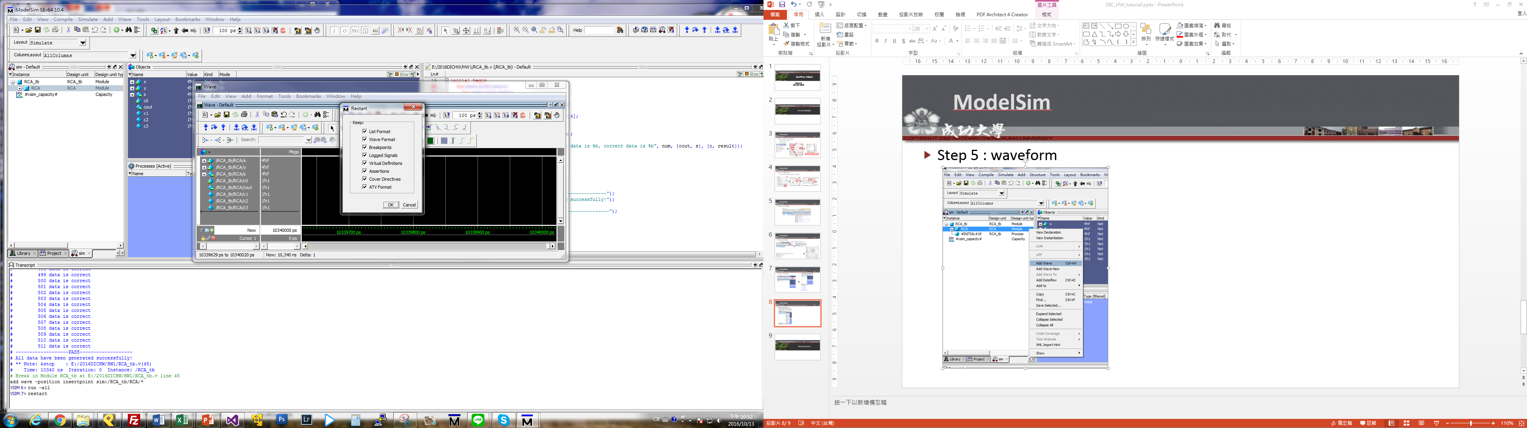
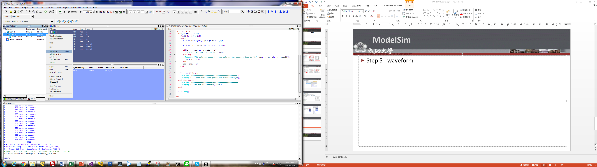
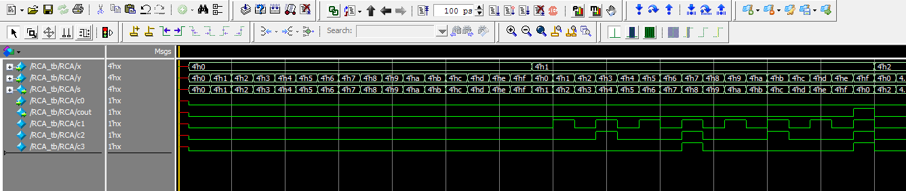
Functional Simulation by ModelSim
You have to “restart” before a new simulation
Step 5 : waveform
Click here

Slide 10
Synthesis by Quartus10.0

Slide 11
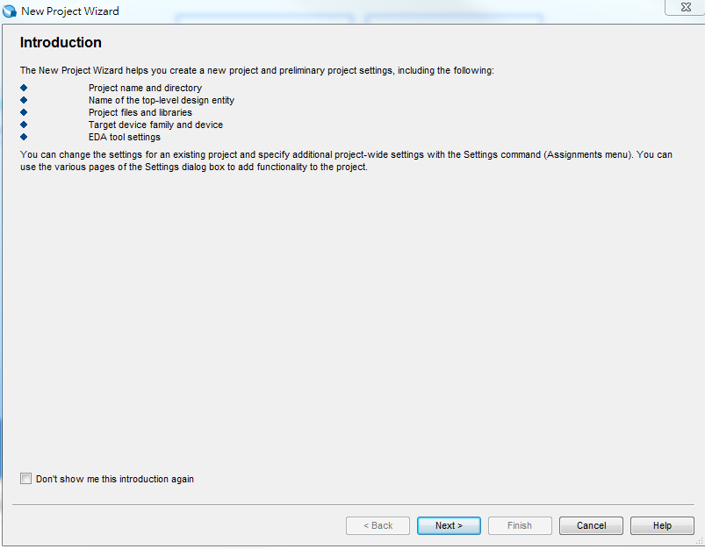
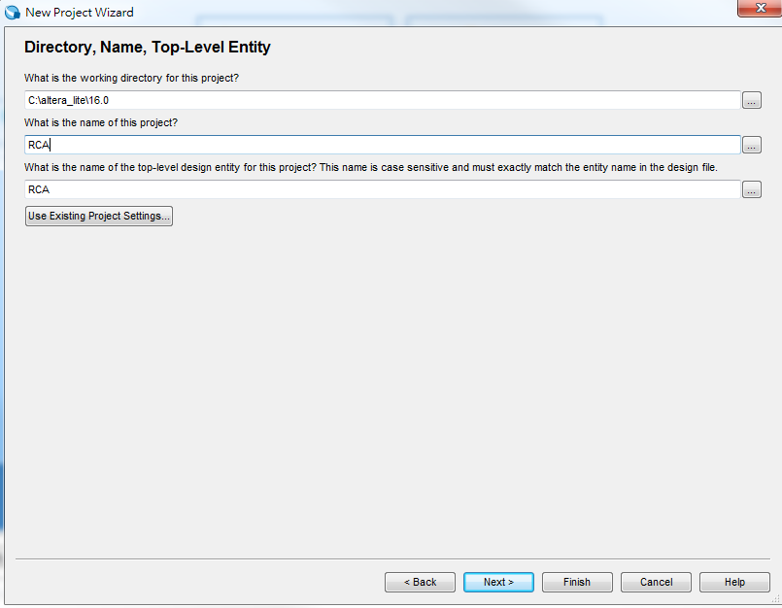
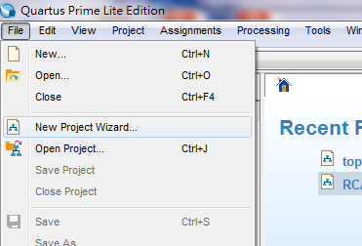
Synthesis by Quartus
Step1: Create a new project
File -> new project wizard
The project path
The project name should be
as same as the name of top module
Click here

Slide 12
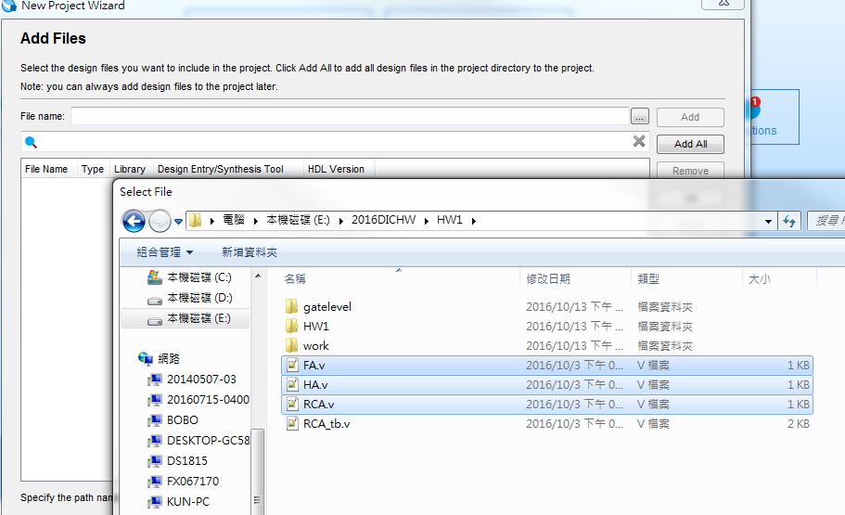
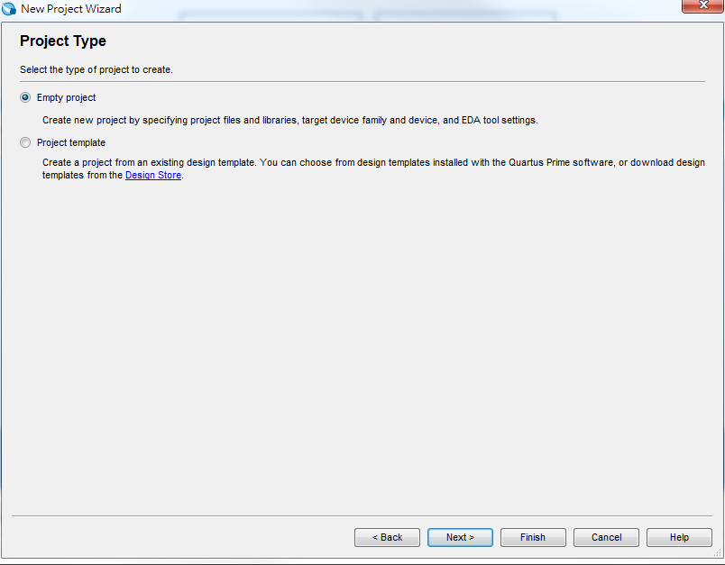
Synthesis by Quartus
Step1: Create a new project
Add the file excepting the testbench
Click here
Click here

Slide 13
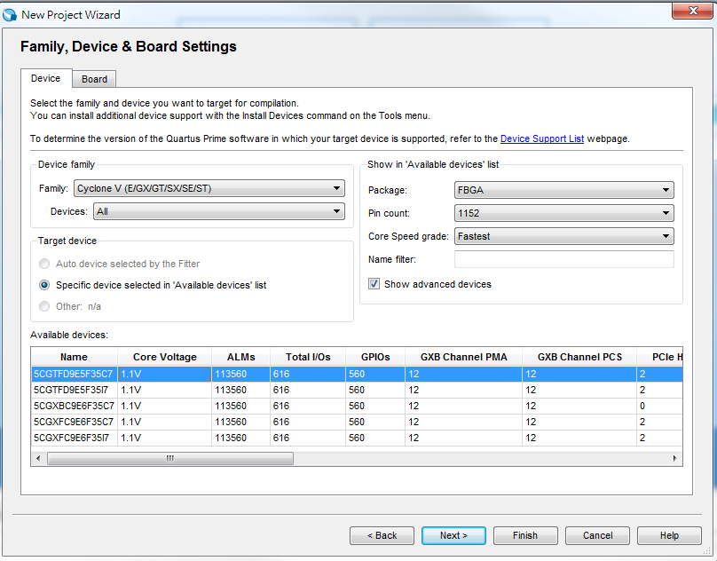
Synthesis by Quartus
Step2: Select the device : Cyclone II EP2C70F896C8

Slide 14
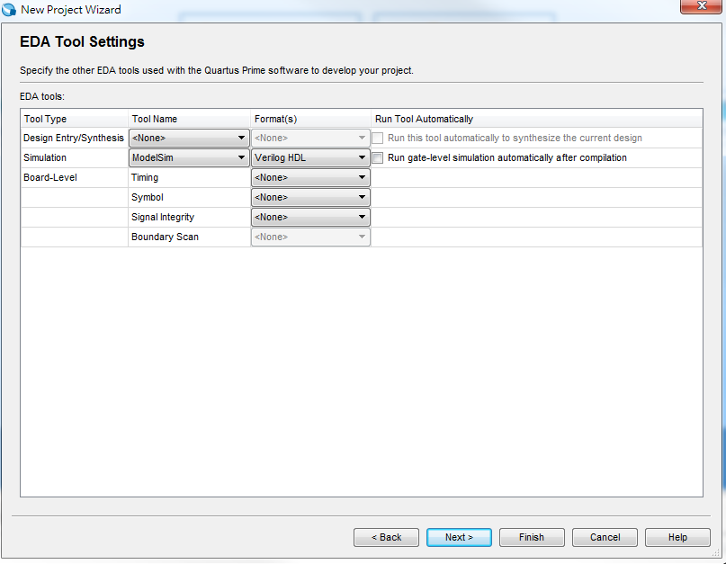
Synthesis by Quartus
Step 3 : Gate level simulation configuration
select ModelSim and Verilog HDL

Slide 15
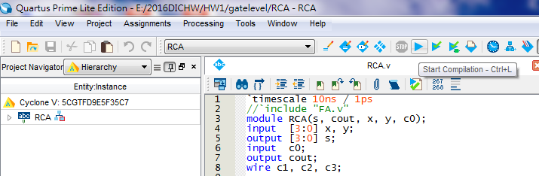
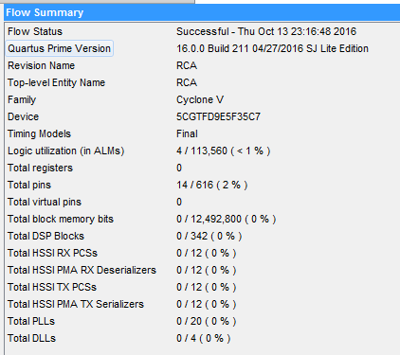
Synthesis by Quartus
Step 4 : compile and you will get the flow summary
Click here

Slide 16
Gate-Level Simulation by ModelSim

Slide 17
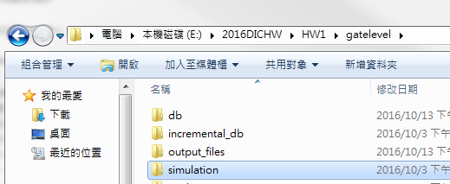
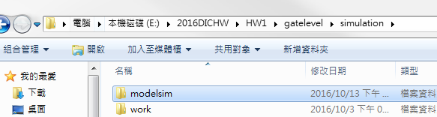
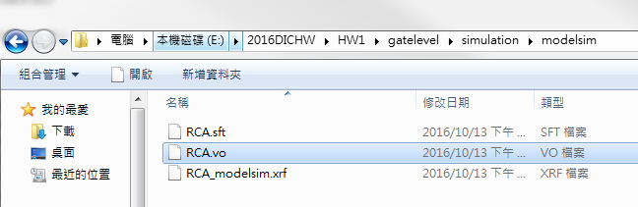
Gate-Level Simulation by ModelSim
Step 1 : the gate level file (*.vo) can be found in simulation/modelsim folder

Slide 18
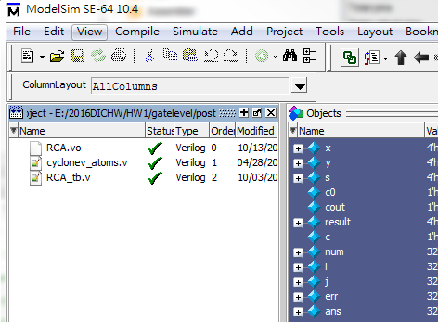
Gate-Level Simulation by ModelSim
Step 2 : gate level simulation
Repeat the steps in pre-sim.
This time, use the *.vo and cyclonev_atoms.v for simulation

